Slide 1
VB.NET Programming
Unit 3

Slide 2
What is Controls ?
GUI Components
Visible to user, and user can interact with
Have properties, methods, and events
“Control” class is the base class for all
Two way to add control
  Design Time
  Run Time

Slide 3
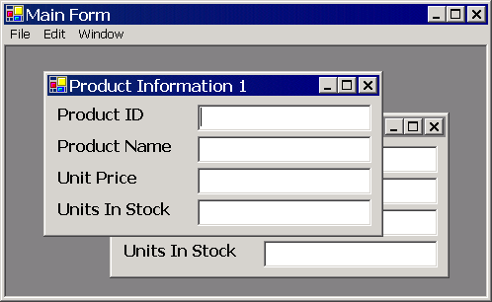
Form
Single Document interface (SDI)
Multiple Document interface (MDI)

Slide 4
Button
  Mnemonics
TextBox
Label
Link Label
CheckBox
RadioButton
DateTimePicker

Slide 5
ListBox
CheckedListBox
ComboBox
PictureBox
RichTextBox
TreeView
ListView

Slide 6
ToolTip
ProgressBar
MaskedTextBox
Notify Icon

Slide 7
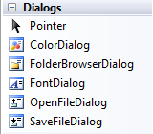
Dialog Boxes
Color Dialog Box
Font Dialog Box
File Open Dialog Box
File Save Dialog Box
Folder Browser Dialog Box

